Slide 1
Krone Diller vest mod
Your anti-personel and low payload drone detector
Sebastian Russo
Javier Peres
Domokos Kertesz
Vilmos Katona

Slide 2

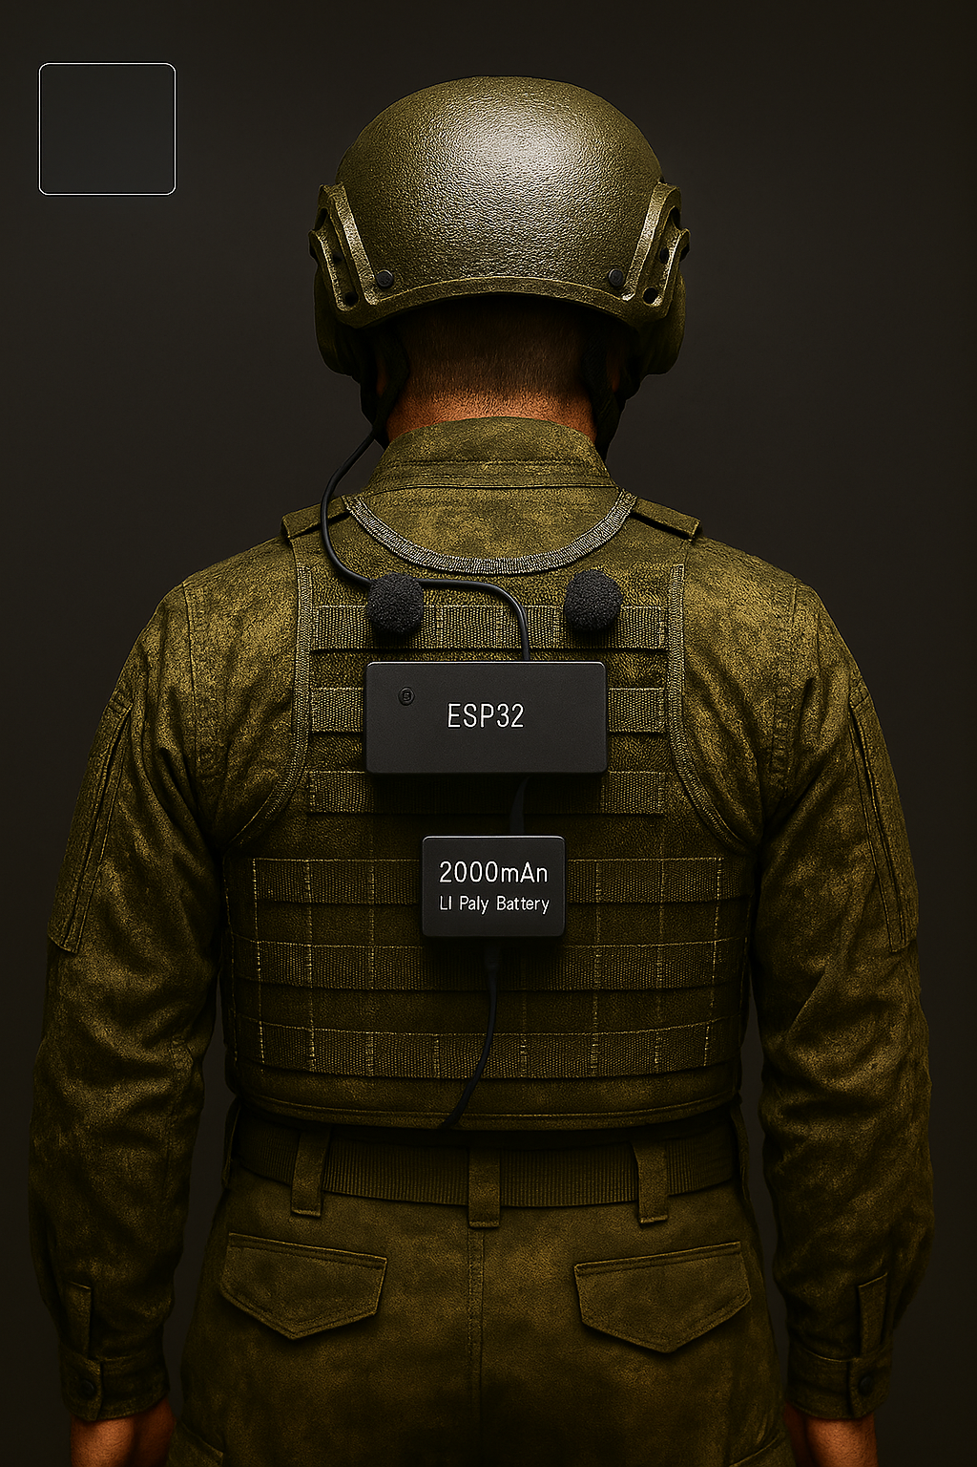
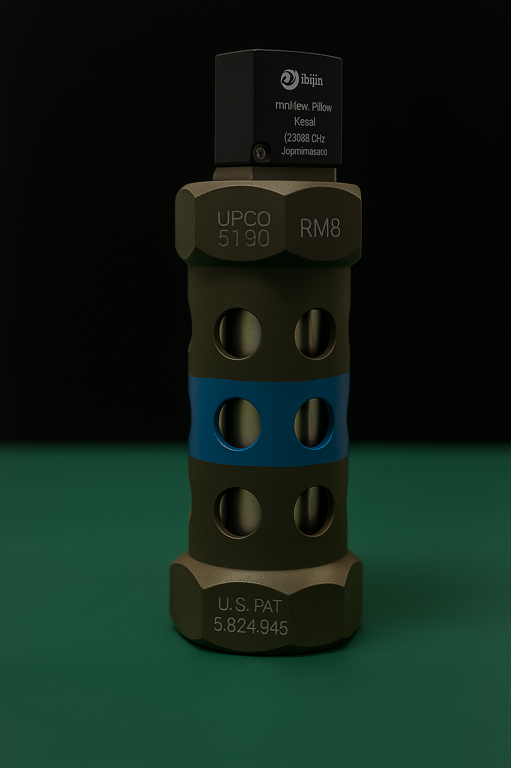
Vest audio-based add-on
Intelligent proximity grenade

Slide 3
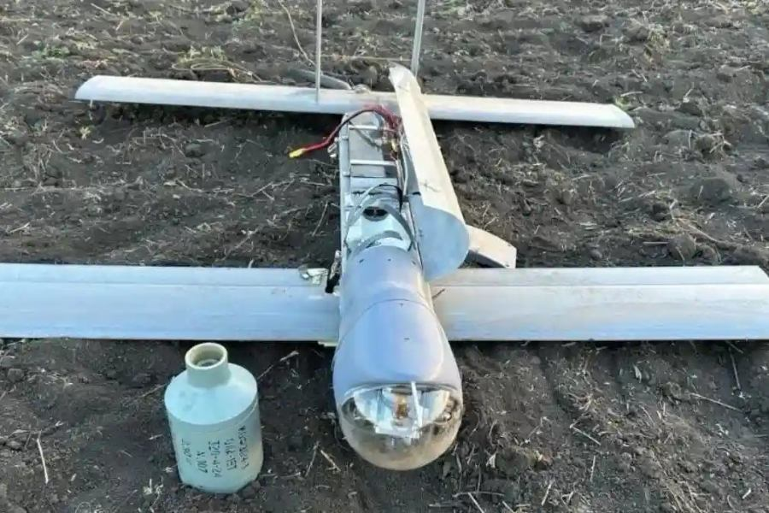
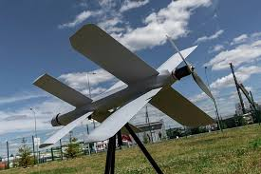
Drones = Danger
- In modern warfare, small commercial drones are a very common threat to dismounted soldiers, specially in open fields.
- A lone soldier that has no early-warning, limited situational awareness, and no passive means of detecting incoming drones is at risk of getting injured or worse.
V2U Loitering munition with a payload ≈ 3kg
Lancet Loitering munition with a payload ≈ 1-3kg

Slide 4
Solution
A lightweight sound-based add-on that identifies drones based on their unique sound profile using DSP and models with 4 synchronized microphones to pinpoint the exact direction the drone is coming and notify the soldier through the communication system in their helmets.
(All components are overexaggerated for clarity)

Slide 5
Technicalities
Hardware |  | Software
ESP32-S3 Dev Module (~10 g, €6–15) |  | Audio Capture: 4× I²S microphones (front/back) at 16 kHz
4× MEMS I²S Microphones (~16 g, €6–15) |  | Rolling Buffer: stores 2-4 s of audio for pre-trigger context
2,000 mAh Li-Po Battery (~50 g, €6–15) |  | Auto-Calibration: per-mic gain normalization at startup
Enclosure, Wiring & Mounts (~15–20 g, €5–12) |  | DSP Filters: Digital notch filters + wind-noise suppression
Wind-Noise Reduction Foam (<1 g) |  | Duty-Cycled ML Inference: Energy detector triggers ML when needed only
Total Weight | ~90 g | ML Model: Lightweight audio classifier for drone detection
Total Cost | €25–60 | Output: Alerts to helmet comms with detection & direction
Estimated runtime of around 8 hours of uninterrupted, can be extended significantly in various ways

Slide 6
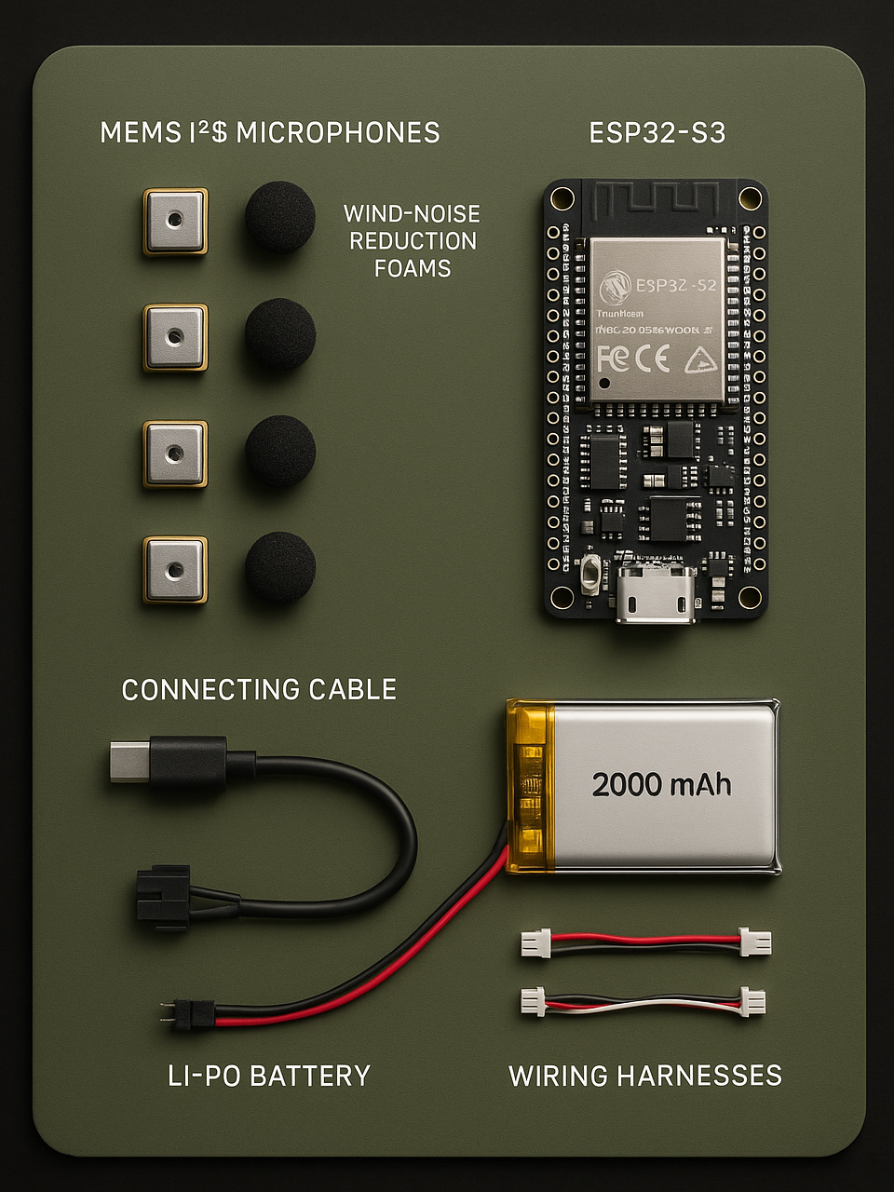
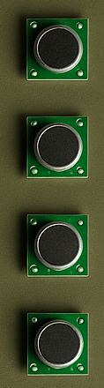
Product value
Low Cost (€25–60 per unit)
Lightweight System (~90 to 120 g total)
Long Battery Life (~8 hours continuous)
360° Acoustic
Reliable Drone Identification
Low False-Alarm Operation
Automatic Self-Calibration
Environmental Noise Resistance
Efficient by Duty-Cycled Processing
Notification though embedded coms
Rugged and Modular Hardware
Can detect drones 100-900m

Slide 7
Limitations
Extremely noisy environments like an active battlefield can mask the drone’s sound profile.
Limited ML complexity and computational power on the ESP32-S3.
Limited dataset of audios.
Microphones are sensitive to moisture and mud.
Battery life (~8 hours), it can be extended by increasing the battery size but would also increase weight.
Heavy rain, wind, and environmental noise reduce detection range and direction accuracy.
Rapid soldier movement or complex terrain (urban echo, forest clutter) can degrade localization to some extent.
Compatibility with different helmet communication systems may vary unless standardized.
Short rolling audio buffer limits forensic or post-event analysis since it needs to be as optimized as possible.
System does not counter or disable drones perse. it should warn the soldier long enough to react.
Fast FPV drones may offer only a brief acoustic warning window, reducing reaction time.

Slide 8
Thank you!!!
Questions?

